Slide 1
Principles of Microservices

Slide 2
Model Around Business Concepts
Interfaces structured around business-bounded contexts are more stable than those structured around technical concepts.
They are better able to reflect changes to business processes
Use bounded contexts to define potential domain boundaries

Slide 3
Bounded Contexts
Bounded contexts try to define boundaries of a complex domain into business context.
Bounded contexts are important because they allow us to define an ubiquitous language that is shared and valid within a boundary.
The meaning of a product for the shipping bounded context is not the same as for the product bounded context.
The domain expert of the product may not understand anything about the shipping rules or what box to use to deliver the product to the customer.
However, this information is part of day to day activity of the delivery domain expert and he may even be able to help you to automate part of the system.

Slide 4
Adopt a Culture of Automation
Microservices add more moving parts
A culture of automation to handle complexity
Automates testing and continuous delivery

Slide 5
Hide Internal Implementation Details
Allows services to evolve independently
Modeling bounded contexts can help, as this helps us focus on those models that should be shared, and those that should be hidden.
Services should also hide their databases to avoid tight coupling
Use data pumps to consolidate data
Pick technology-agnostic APIs to give you freedom to use different technology stacks.

Slide 6
Hide Internal Implementation Details
Consider using REST, which formalizes the separation of internal and external implementation details
Although even if using remote procedure calls (RPCs), you can still embrace these ideas.

Slide 7
Decentralize All the Things
Delegate decision making and control to the teams that own the services themselves
Allow people to test/deploy software on demand
Make teams responsible for the changes that are made
Have them decide when to release changes.

Slide 8
Independently Deployable
Ensure that microservices can and are deployed by themselves.
When breaking changes are required, we should seek to coexist versioned endpoints to allow consumers to change over time
Adopt a one-service-per-host model, you reduce side effects that could cause deploying one service to impact another unrelated service.
Using blue/green or canary release techniques to separate deployment from release

Slide 9
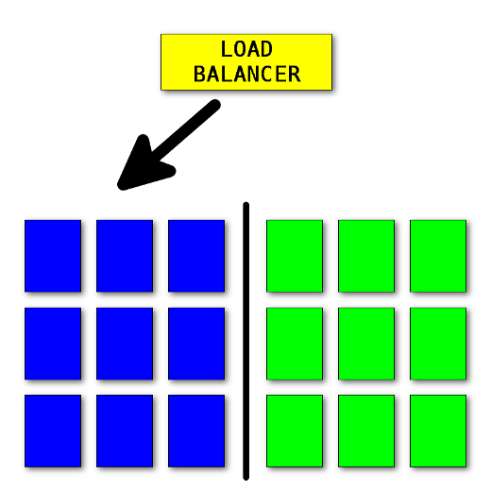
Blue Green Deployment
Blue-green deployment is about having two identical environments, in front of which there is a router or load balancer that allows you to direct traffic to the appropriate environment

Slide 10
Blue Green Deployment
Both of our applications are currently running, but only blue is getting the entire traffic.
In the meantime, the green version goes through all necessary tests (integration, end-to-end, etc.).
When we are satisfied that the new version is working properly, we can flip the switch and route the entire traffic to the green environment

Slide 11
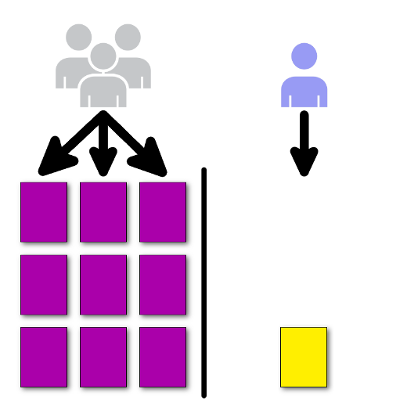
Canary Deployment
Canary is about deploying an application in small, incremental steps, and only to a small group of people

Slide 12
Canary Deployment
We want to verify whether the new version of the application is working correctly in our "production" environment.
We want to expose it only to a small amount of clients—to gather feedback
For that we need to configure the route in such a way that only a small percent of the incoming traffic is forwarded to the newer (canary) version of the application

Slide 13
Independently Deployable
It should be the norm, not the exception, that you can make a change to a single service and release it into production, without having to deploy any other services in lock-step.
Your consumers should decide when they update themselves, and you need to accommodate this.

Slide 14
Isolate Failure
A microservice architecture can be more resilient than a monolithic system, but only if we understand and plan for failures in part of our system.
If we don’t account for the fact that a downstream call can and will fail, our systems might suffer catastrophic cascading failure

Slide 15
Isolate Failure
When using network calls, don’t treat remote calls like local calls, as this will hide different sorts of failure mode.
Make sure your timeouts are set appropriately.
Use bulkheads and circuit breakers to limit the fallout of a failing component
Know what the implications of a network partition might be, and whether sacrificing availability or consistency in a given situation is the right call.

Slide 16
Bulkhead Pattern
Bulkhead isolates critical resources, such as connection pool, memory, and CPU, for each workload or service.
By using bulkheads, a single workload (or service) can’t consume all of the resources, starving others.
This pattern increases the resiliency of the system by preventing cascading failures caused by one service.

Slide 17
Circuit Breakers
A service client should invoke a remote service via a proxy that functions in a similar fashion to an electrical circuit breaker.
When the number of consecutive failures crosses a threshold, the circuit breaker trips, and for the duration of a timeout period all attempts to invoke the remote service will fail immediately.
After the timeout expires the circuit breaker allows a limited number of test requests to pass through. If those requests succeed the circuit breaker resumes normal operation.

Slide 18
Highly Observable
We need a joined-up view of what is happening.
Use semantic monitoring to see if your system is behaving correctly, by injecting synthetic transactions into your system to simulate real-user behavior.
Aggregate your logs, and aggregate your stats, so that when you see a problem you can drill down to the source.
And when it comes to reproducing nasty issues or just seeing how your system is interacting in production, use correlation IDs to allow you to trace calls through the system.

Slide 19
Semantic Monitoring
Semantic monitoring (a.k.a. synthetic monitoring) runs a subset of an application's automated tests against the live production system on a regular basis.
The results are pushed into the monitoring service, which triggers alerts in case of failures.
This technique combines automated testing with monitoring in order to detect failing business requirements in production.

Slide 20
Microservices Patterns
https://microservices.io/patterns/
Source: Newman’s book

